Slide 1
Powiedzenia i przysłowia

Slide 2
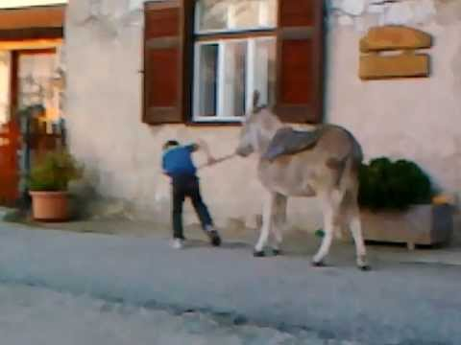
As stubborn as a donkey uparty jak osioł
My sister is as stubborn as a donkey.

Slide 3
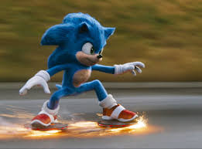
As fast as lightning Szybki jak błyskawica.
Messi can run very fast at the football pitch. He is as fast as ligtning.

Slide 4
As white as a sheet. Blady jak ściana
Look at Tom .
He is as white as a sheet. Is he ok.?

Slide 5
As proud as a peacock Dumny jak paw
My sister was as proud as a peacock when she won the prize.

Slide 6
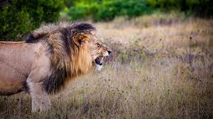
As brawe as a lion Odważny jak lew
My dad is as brawe as a lion. He can go out at night.

Slide 7
As wise as an owl Mądry jak sowa
My sister is as wise as an owl. She always gets good marks at school.

Slide 8
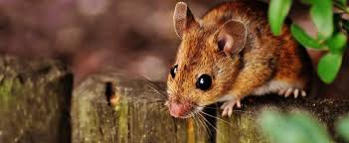
As quiet as a mouse Cichy jak myszka
I can’t hear him. He is as quiet as a mouse.

Slide 9
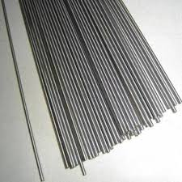
As easy as a pie Prosty jak drut
This exercise wasn’t difficult. It was as easy as a pie.

Slide 10
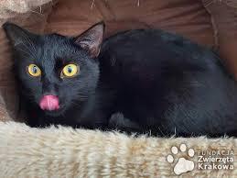
As dark as coal Czarny jak węgiel
My eyes are very dark. They are as dark as coal.

Slide 11
Dziękuję za obejrzenie Igor Gilewski

